Slide 1
What is a Power Diode?
A two-terminal semiconductor device that allows current flow in one direction
Designed to handle high voltages (up to several kV) and high currents (up to several kA)
Used for rectification, freewheeling, and voltage clamping
Key difference from signal diodes: Thicker drift region for high voltage blocking

Slide 2
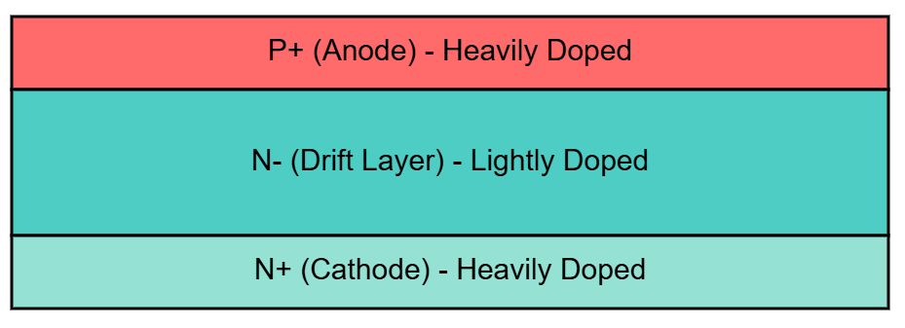
Power Diode Structure

Slide 3
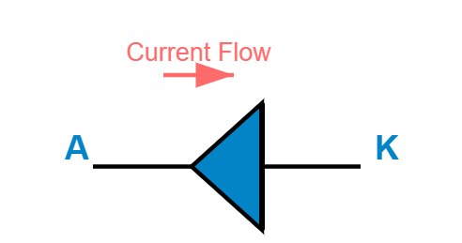
Power Diode Symbol

Slide 4
Doping Levels in Power Diodes
P+ layer (Anode): ~10 cm, thickness ~10 μm
N- drift layer: ~10 cm, thickness 50-250 μm
N+ layer (Cathode): ~10 cm, thickness ~250 μm
Drift layer thickness determines breakdown voltage

Slide 5
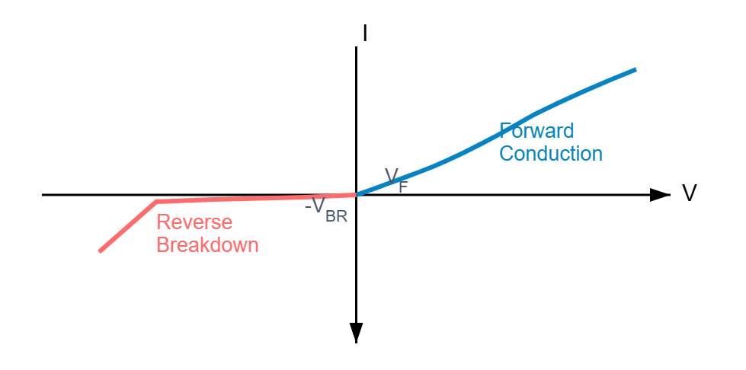
V-I Characteristics of Power Diode

Slide 6
Forward Characteristics
Diode conducts when anode is positive with respect to cathode
Threshold voltage V: ~0.7V for Si, ~0.3V for Schottky
Forward voltage drop: V = V + r × I
On-state resistance r causes power dissipation

Slide 7
Reverse Characteristics
Diode blocks current when cathode is positive
Small reverse leakage current I flows (μA to mA range)
Reverse breakdown occurs at voltage V
Breakdown voltage depends on drift layer width and doping

Slide 8
Diode Equation
I = I [e - 1]
Where:
I = Reverse saturation current
q = Electron charge (1.6 × 10 C)
V = Applied voltage across diode
k = Boltzmann constant (1.38 × 10 J/K)
T = Absolute temperature (K)

Slide 9
Power Dissipation in Diodes
P = V × I
P = V × I + r × I
Higher current increases power loss
Requires proper heat sinking for thermal management

Slide 10
Diode Turn-On Characteristics
Forward voltage initially overshoots to V
Forward recovery time t: Time to reach steady-state V
Overshoot depends on current rise rate di/dt
Minority carriers gradually accumulate across junction

Slide 11
Diode Turn-Off Characteristics
Reverse recovery occurs when diode switches from forward to reverse
Reverse recovery time t: Time for stored charge to dissipate
Peak reverse current I flows during recovery
Reverse recovery charge Q determines switching loss

Slide 12
Reverse Recovery Time Equation
t = √[2Q / (di/dt)]
Q = Reverse recovery charge
di/dt = Rate of change of current
Fast recovery diodes have lower t (few ns to μs)
Standard diodes have t in μs range

Slide 13
Types of Power Diodes
Standard Recovery Diodes: t > 5 μs (line frequency applications)
Fast Recovery Diodes: t = 1-5 μs (DC-DC converters)
Schottky Diodes: Very low V, fast switching, low voltage rating
SiC Diodes: High voltage, high temperature, near-zero t

Slide 14
Power Electronics Switches
Controllable semiconductor devices used for switching in power converters

Slide 15
Types of Power Switches
Power MOSFET (Metal-Oxide-Semiconductor Field-Effect Transistor)
IGBT (Insulated Gate Bipolar Transistor)
Thyristor/SCR (Silicon Controlled Rectifier)
GTO (Gate Turn-Off Thyristor)

Slide 16
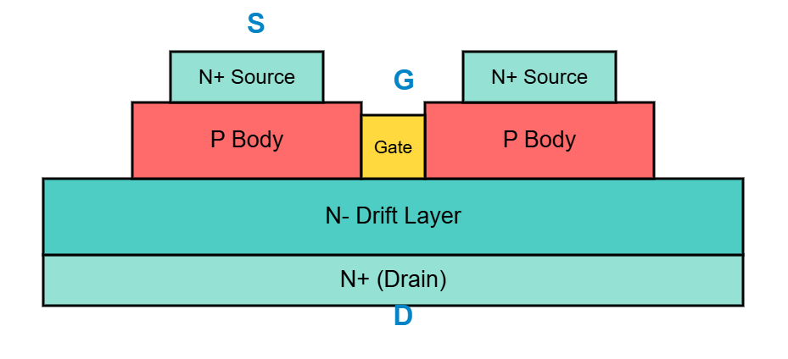
Power MOSFET Structure

Slide 17
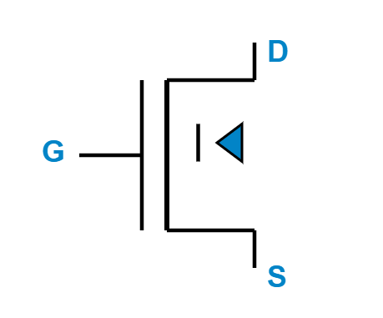
MOSFET Symbol (N-Channel)

Slide 18
MOSFET Operating Principle
Voltage-controlled device: Gate voltage controls drain current
When V > V: Channel forms, device conducts
When V < V: No channel, device blocks
Unipolar device: Only majority carriers (electrons) conduct

Slide 19
MOSFET Key Characteristics
Very fast switching speed (nanoseconds)
High input impedance (low gate drive power)
Positive temperature coefficient (prevents thermal runaway)
On-state resistance R causes conduction loss

Slide 20
MOSFET Equations
Linear Region (V < V - V):
I = K × [(V - V)V - V/2]
Saturation Region (V > V - V):
I = (K/2) × (V - V)

Slide 21
MOSFET Conduction Loss
P = I × R
R increases with temperature
Lower R MOSFETs reduce power loss
Trade-off: Lower R means higher gate charge

Slide 22
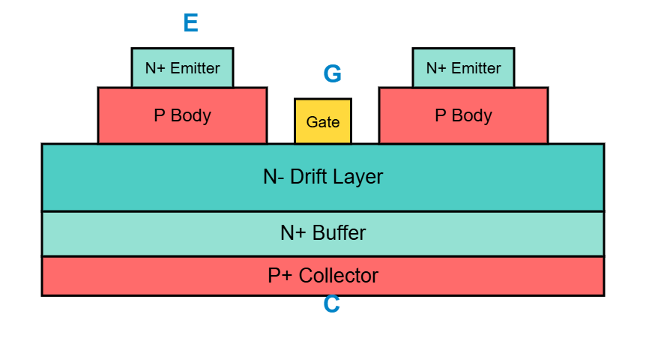
IGBT Structure
Combines MOSFET input with BJT output

Slide 23
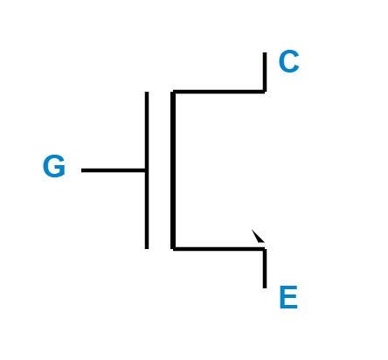
IGBT Symbol

Slide 24
IGBT Operating Principle
Input stage: MOSFET controls gate (voltage-controlled)
Output stage: Bipolar transistor conducts collector current
Combines low gate drive power of MOSFET with low on-state loss of BJT
Bipolar conduction enables high current density

Slide 25
IGBT Key Characteristics
Lower on-state voltage drop than MOSFET (1.5-3V typical)
Moderate switching speed (microseconds)
Tail current during turn-off increases switching loss
High voltage rating (600V to several kV)

Slide 26
MOSFET vs IGBT
MOSFET
IGBT
Fast switching (ns)
Higher R
Low-medium voltage
High frequency apps
Moderate speed (μs)
Lower V
High voltage
High power apps

Slide 27
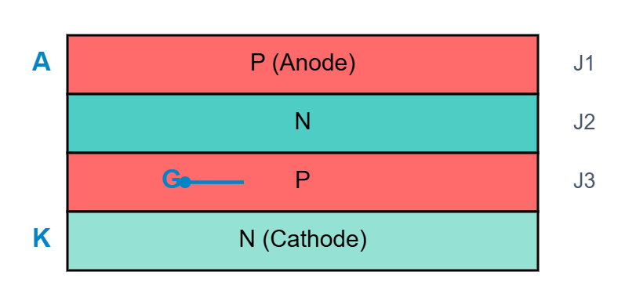
Thyristor (SCR) Structure
Four-layer P-N-P-N structure

Slide 28
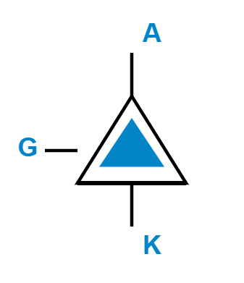
Thyristor (SCR) Symbol

Slide 29
Thyristor Operating Principle
Turn-on: Positive gate current triggers device when anode is positive
Latching: Once on, gate loses control (regenerative action)
Turn-off: Requires anode current to drop below holding current
Cannot be turned off by gate signal alone

Slide 30
Thyristor Key Characteristics
Latching current I: Minimum to maintain conduction
Holding current I: Minimum to keep device on
Very high voltage and current ratings
Low on-state voltage drop (~1-2V)

Slide 31
Gate Turn-Off Thyristor (GTO)
Similar four-layer structure to SCR
Modified gate design enables turn-off capability
Turn-on: Positive gate pulse
Turn-off: Negative gate current pulse extracts stored charge

Slide 32
GTO Key Characteristics
Full gate control (turn-on and turn-off)
Turn-off gain: 3-5 (negative gate current = 20-30% of anode current)
High voltage and current capability
Used in high-power inverters and motor drives

Slide 33
Silicon Carbide (SiC) Devices
Wide bandgap semiconductor material
10× higher breakdown field than silicon
Operates at higher temperatures (up to 200°C)
Near-zero reverse recovery time for diodes

Slide 34
SiC Device Advantages
5× higher current density than silicon
Much faster switching under high voltage/temperature
Lower conduction and switching losses
Enables smaller passive components (inductors, capacitors)

Slide 35
Power Electronics in Electric Vehicles
Key Applications and Implementations

Slide 36
Traction Inverter
Converts DC from battery to 3-phase AC for motor
Uses IGBT or SiC MOSFET switches in 3-phase bridge
Controls motor speed and torque via PWM
Handles regenerative braking (motor acts as generator)

Slide 37
Power Devices in Traction Inverter
IGBTs: Traditional choice for 400V systems
SiC MOSFETs: Preferred for 800V systems (higher efficiency)
Freewheeling diodes: Handle reverse current during switching
SiC diodes reduce reverse recovery loss significantly

Slide 38
DC-DC Converters in EVs
Buck converter: Steps down high voltage battery to 12V/48V auxiliary
Boost converter: Steps up voltage for certain motor topologies
Bidirectional converter: Enables energy flow in both directions
Power switches: MOSFETs for lower voltages, IGBTs for high power

Slide 39
Buck Converter Configuration
MOSFET as main switch (high-side)
Freewheeling diode conducts when MOSFET is off
Fast recovery diode reduces switching loss
Synchronous buck replaces diode with MOSFET for higher efficiency

Slide 40
Onboard Charger (OBC)
Converts AC from grid to DC for battery charging
AC-DC rectifier: Uses power diodes or active rectification (MOSFETs)
DC-DC stage: Controls charging current and voltage
SiC devices improve efficiency and reduce size/weight

Slide 41
BMS Power Electronics
Precharge circuit: Uses power resistor and relay/contactor
Power diodes prevent reverse current flow
Cell balancing circuits: Use MOSFETs to discharge/charge cells
Isolation monitoring: Protects against ground faults

Slide 42
Device Selection Criteria
Voltage rating: Must exceed maximum system voltage (safety margin)
Current rating: Based on peak and continuous current requirements
Switching frequency: MOSFETs for >20kHz, IGBTs for <20kHz
Thermal management: Junction temperature and cooling requirements

Slide 43
Summary
Power diodes enable rectification and freewheeling
MOSFETs excel at high-frequency switching
IGBTs handle high voltage and high power efficiently
SiC devices revolutionize EV power electronics
Proper device selection is critical for EV performance

